Slide 1

What’s Next? :
Anime Recommender System
Tham Zhi Cong

Slide 2
Content
Introduction
Data Cleaning and EDA
Content Based recommender
Collaborative Based recommender
Conclusion and future steps

Slide 3
Introduction
Problem Statement
To create a recommendation system using an anime dataset and understand how ‘good’ the recommendations are
Evaluation: How many recommendations are relevant to users?

Slide 4
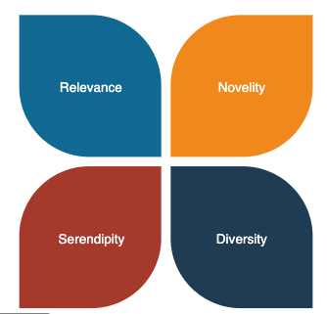
Recommender Systems
Relevance
Novelty
Serendipity
Diversity

Slide 5
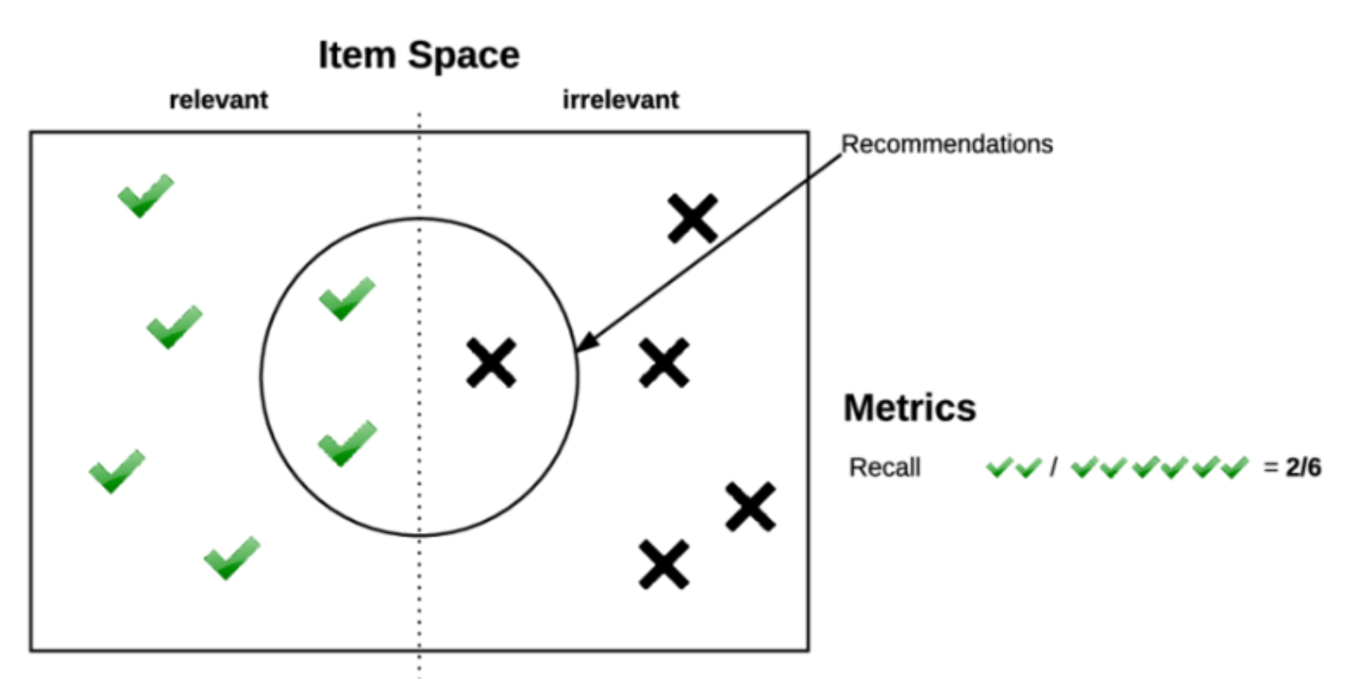
Relevance
How many items out of total recommendations does user like
Similar to ‘accuracy’

Slide 6
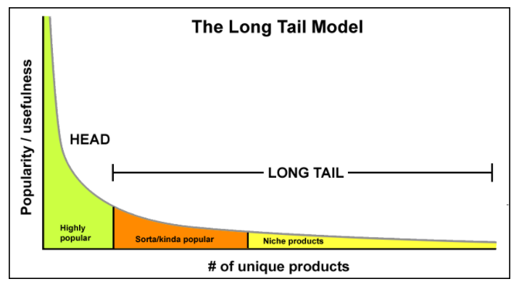
Novelty
Recommend what the user has not already been exposed to
Determines how unknown recommended items are to users
Measures how new, original or unusual the recommendation is
Counter to accuracy

Slide 7
Serendipity
Element of ‘surprise’
Recommends beyond what is highly popular
Solution to ‘long tail’ and ‘cold-start’ problem
Counter to accuracy
No agreed upon standard of measurement
A measure of the extent to which recommendations positively surprise their users

Slide 8
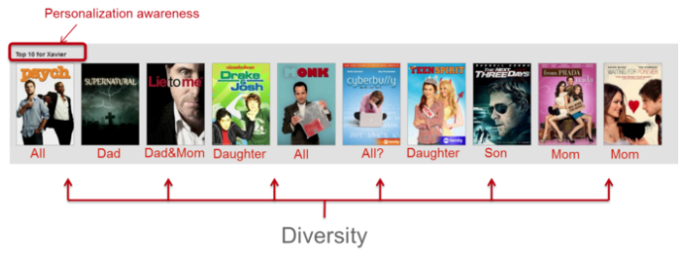
Diversity
Measures how narrow or wide the spectrum of recommended products are.
Good diversity indicates wide range of products / genres etc.

Slide 9
Data Cleaning and EDA

Slide 10
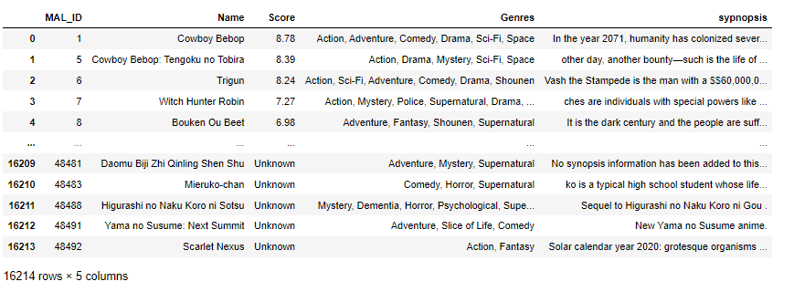
Data Cleaning and EDA
Datasets: anime (12,294 rows x 7 cols) - to year 2018
synopsis (16,214 rows x 5 cols)
rating (7,813,737 rows x 3 cols)

Slide 11
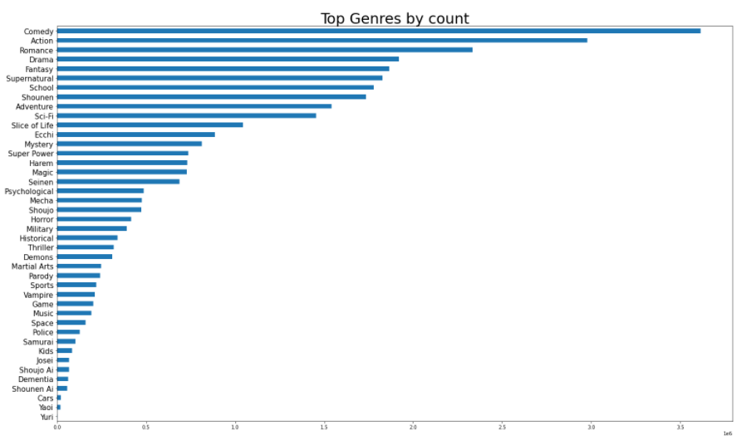
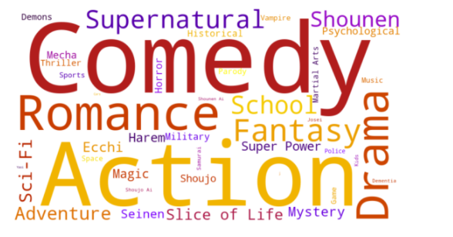
Data Cleaning and EDA
Genre
Top genres are ‘comedy’, ‘action’, ‘romance’, ‘fantasy’, and ‘drama’.

Slide 12
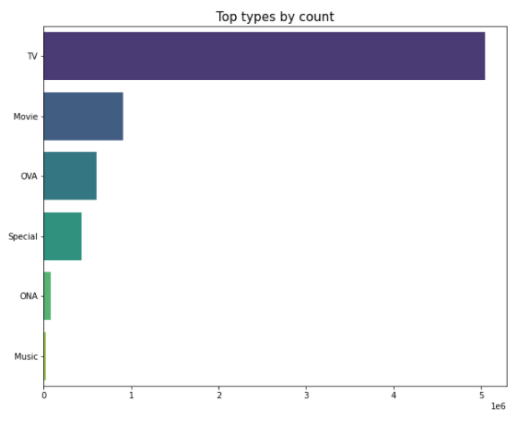
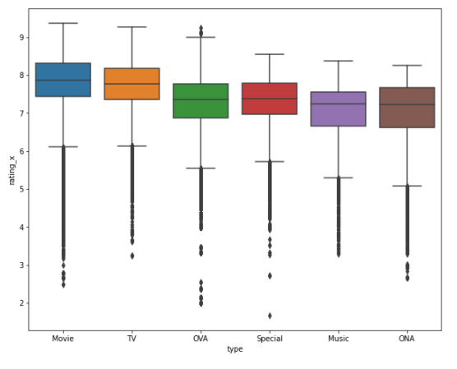
Data Cleaning and EDA
Type
‘TV’ is the most common type, with ‘music’ the least common.
Movies have slightly higher average score compared to other types.

Slide 13
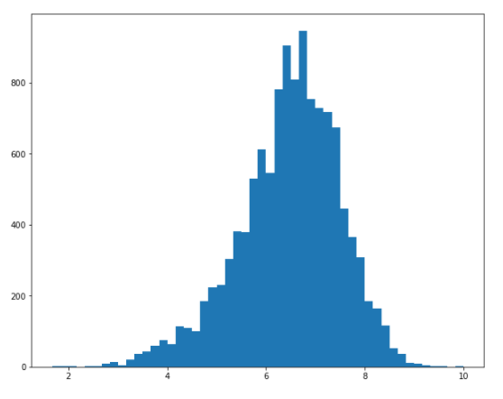
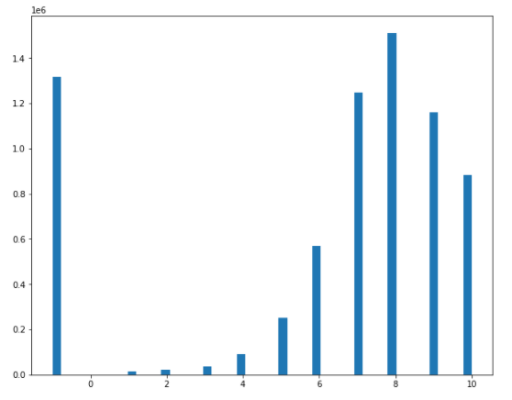
Data Cleaning and EDA
Rating
Most average scores are observed to range from 4 to 8.
A score of -1 indicates user has watched but not given a rating.

Slide 14
Content Based filtering

Slide 15
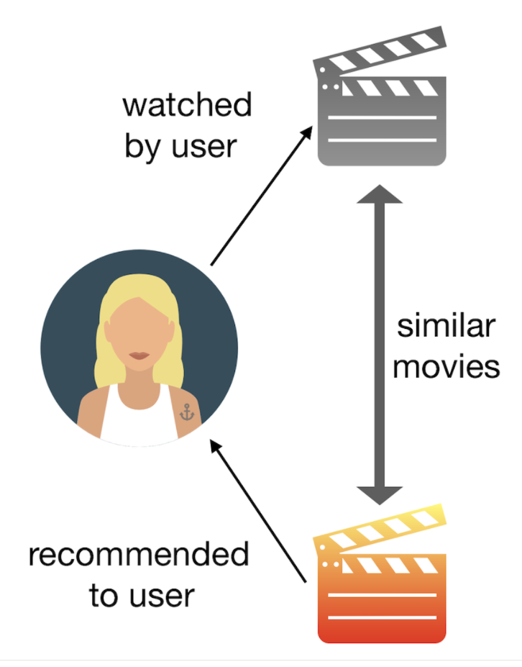
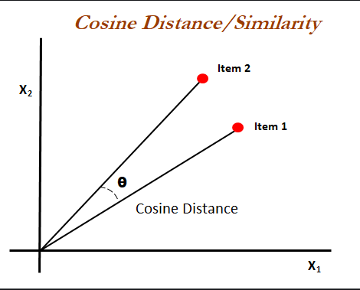
Content Based filtering
Using item features to recommend items similar to what the user likes (eg. categories, genres, types)
Easy to implement
Highly relevant to user
Lacks in novelty and serendipity

Slide 16
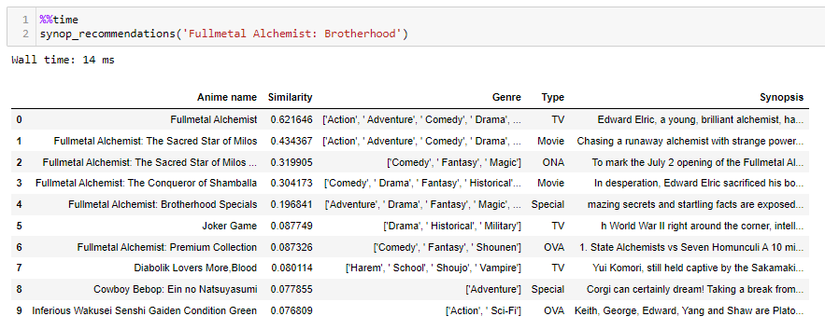
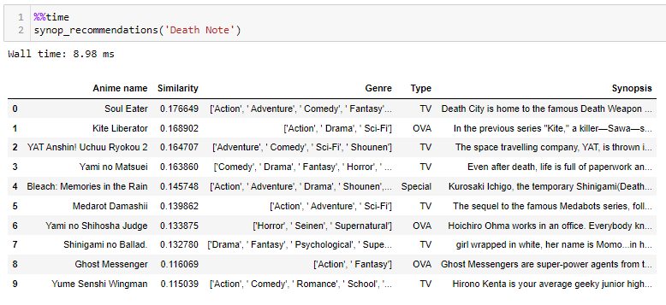
Content Based filtering
Synopsis
TFIDF Vectorizer
(1, 4 n-grams)
Cosine Similarity
(similarity between
word/phrase vectors)

Slide 17
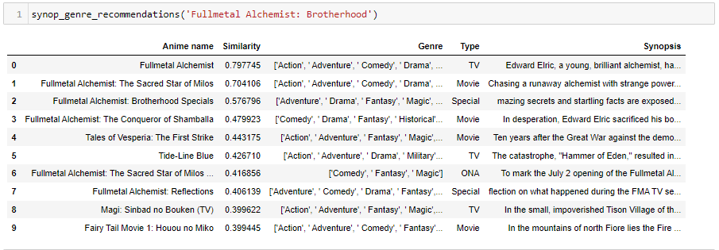
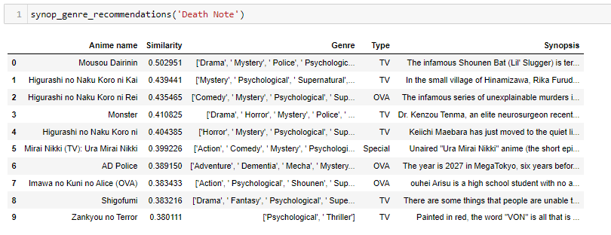
Content Based filtering
Genre
TFIDF Vectorizer
(1, 1 n-grams)
Synopsis
TFIDF Vectorizer
(1, 4 n-grams)
Cosine Similarity

Slide 18
Collaborative Based filtering

Slide 19
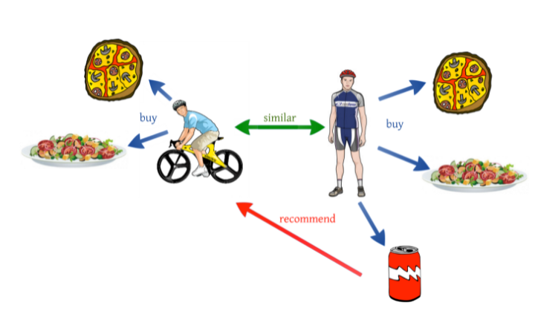
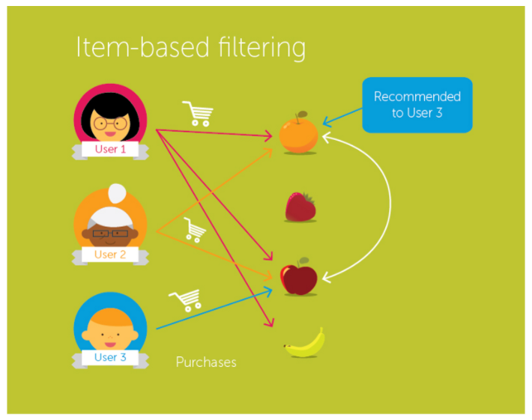
Collaborative Based filtering
Using similarity between users / items to recommend items
Requires user rating for recommendation
Prone to cold start problem
Provides novelty and serendipity, lacks in relevance

Slide 20
Collaborative Based filtering
Memory based techniques
rely heavily on simple similarity measures (Cosine similarity, Pearson correlation, Jaccard coefficient etc) to match similar people or items together
considered more memory intensive as compared to model based techniques
Model based techniques
“guess” how much a user will like an item that they did not encounter before
utilize machine learning algorithms to train on the vector of items for a specific user

Slide 21
Collaborative Based filtering
SURPRISE recommender library
Memory based techniques
KNNBasic - a basic collaborative filtering algorithm
KNNWithMeans - takes into account mean ratings of each user
Model based techniques
SVD - similar to Probabilistic Matrix Factorization
BaselineOnly - predicts baseline estimate for user and item
NMF - very similar to SVD, user and item factors are kept positive

Slide 22
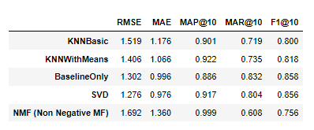
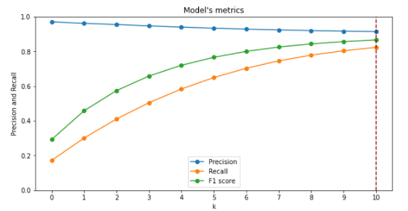
Collaborative Based filtering
Metrics used: RMSE, MAP@K
Users >= 200 ratings
100,000 random rows
Threshold at score of 7
GridSearchCV

Slide 23
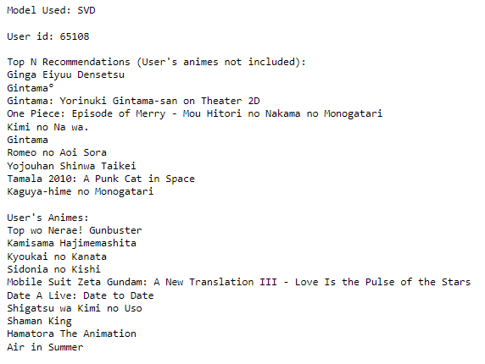
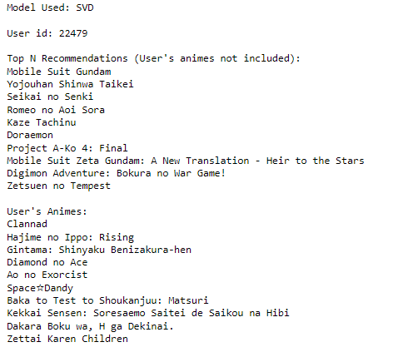
Collaborative Based filtering

Slide 24
Conclusion and future steps
Incorporate more features into content based filtering eg voice actors, animation studios etc.
Try out more models such as co-clustering, SVDpp.
Deploy hybrid based filtering
Do user testing for recommendations

Slide 25
Thank You!

